Slide 1
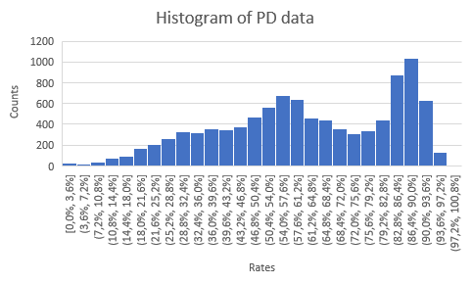
Exploratory data analysis (EDA)
Name of test Statistic | Value
mean | 0,187632927
variance | 0,04900842
maximum | 0,99
minimum | 4,67023E-05
median | 0,500461983
default rate | 0,489434151
There is default rate is higher than the average of PD data
There is high volume of PD value between 82% to 90%
Besides the PD values between 80% to 75.2% the data wold be roughly bell shaped, one could assume that it’s following a normal distribution

Slide 2
EDA for features 1
Looking at the default rates where the feature value is zero vs negative.
Statistic name | Statistic value | Comments
min | - 300 000
max | 0 | No positive values, since the max is zero
average | - 2 158 | Based on eyeballing the dataset, we can see many zeroes. This is probably affecting the average
% of obervations where zero | 88,3% | Due to all the zeroes, we might want to look at the average excluding zeroes. This won't always be the case, it depends on the data and requires some judgement
average ecluding zeroes | - 18 451
median | 0
mode | 0
Row Labels | Sum of default_ind | Count of cust_no | default rate
negative | 321 | 1 168 | 27,5%
zero | 4 566 | 8 817 | 51,8%
Grand Total | 4 887 | 9 985 | 48,9%
negative value for feature 1 has a significnatly lower default rate than customers with a value of zero. This is looks like a promising feature to distinguish between good and bad risk customers

Slide 3
EDA for features 3
Statistic name | Statistic value | Comments
min | - | No negative values the min is zero
max | 999
average | 19
% of obervations where zero | 21,3% | we might want to look at the average excluding zeroes. This average is higher that the average that includes zeros
average ecluding zeroes | 11 352
median | 2
mode | 1
Row Labels | Sum of default_ind | Count of cust_no | default rate
zero | 196 | 2122 | 9,2%
> zero | 4691 | 7863 | 59,7%
Grand Total | 4887 | 9985 | 48,9%
The data does not have negative the values
Customers with a positive value for feature 3 has a significnatly higher default rate than customers with a value of zero.

Slide 4
EDA for features 1
Statistic name | Stat value | Comments
min | -91919 | feature 5 has fewer negative values
max | 12772
average | 2568 | Based on eyeballing the dataset has fewer zeroes and many positive values
% of obervations where zero | 0,3% | Due to all the zeroes, we might want to look at the average excluding zeroes. This average is higher than the original average
average ecluding zeroes | 2575
median | 2076
mode | 0
Row Labels | Sum of default_ind | Count of cust_no | default rate
< zero | 21 | 27 | 77,8%
zero | 24 | 28 | 85,7%
> zero | 7123 | 9930 | 71,7%
Grand Total | 7168 | 9985 | 71,8%
The data has fewer negative values and zeors
Customers with zero value for feature 5 has a significnatly higher default rate than customers with
Customer with a positive value for feature 5 has lower default rate

Slide 5
Actual vs Expected default rates
By creating the PDth percentile of the PD value of each cell and rounding to 2 decimal places
From zero to 35Th percentile the graph is horizontal(constant) for both actual and expected defaults, and from there up to the 87Th percentile graph is increasing, from there onwards graph is decreasing.
This decrease might cause a loss of power overtime.
This can be solved by updating parameter inputs overtime to make the more realistic

Slide 6
Key model metrics
 | Predicted class
Actual class |  | y^=1 | y^=0
 | y=1 | 4492 | 395
 | y=0 | 2471 | 2627
TP rate | 92% | Precision | 92%
FP rate | 14% | Recall | 65%
TN rate | 87% | F1 | 76%
FN rate | 35% | F2 | 69%
The precision is above 60%, that implies that the model is not so bad
The FN parameter trumps the FP, the recall parameter is above 90% which implies that the model is performing well with respect to the positive class
The model has F1 value 76% as a whole the model not performing poor in contribution of both positive and negative classes,
When increasing that increases the FP parameter and reduces the TP parameter, this can imply that the the model incorrectly predicts the positive class when the true class is negative.

Slide 7
Ranking ability
The Gini coefficient

